Slide 1

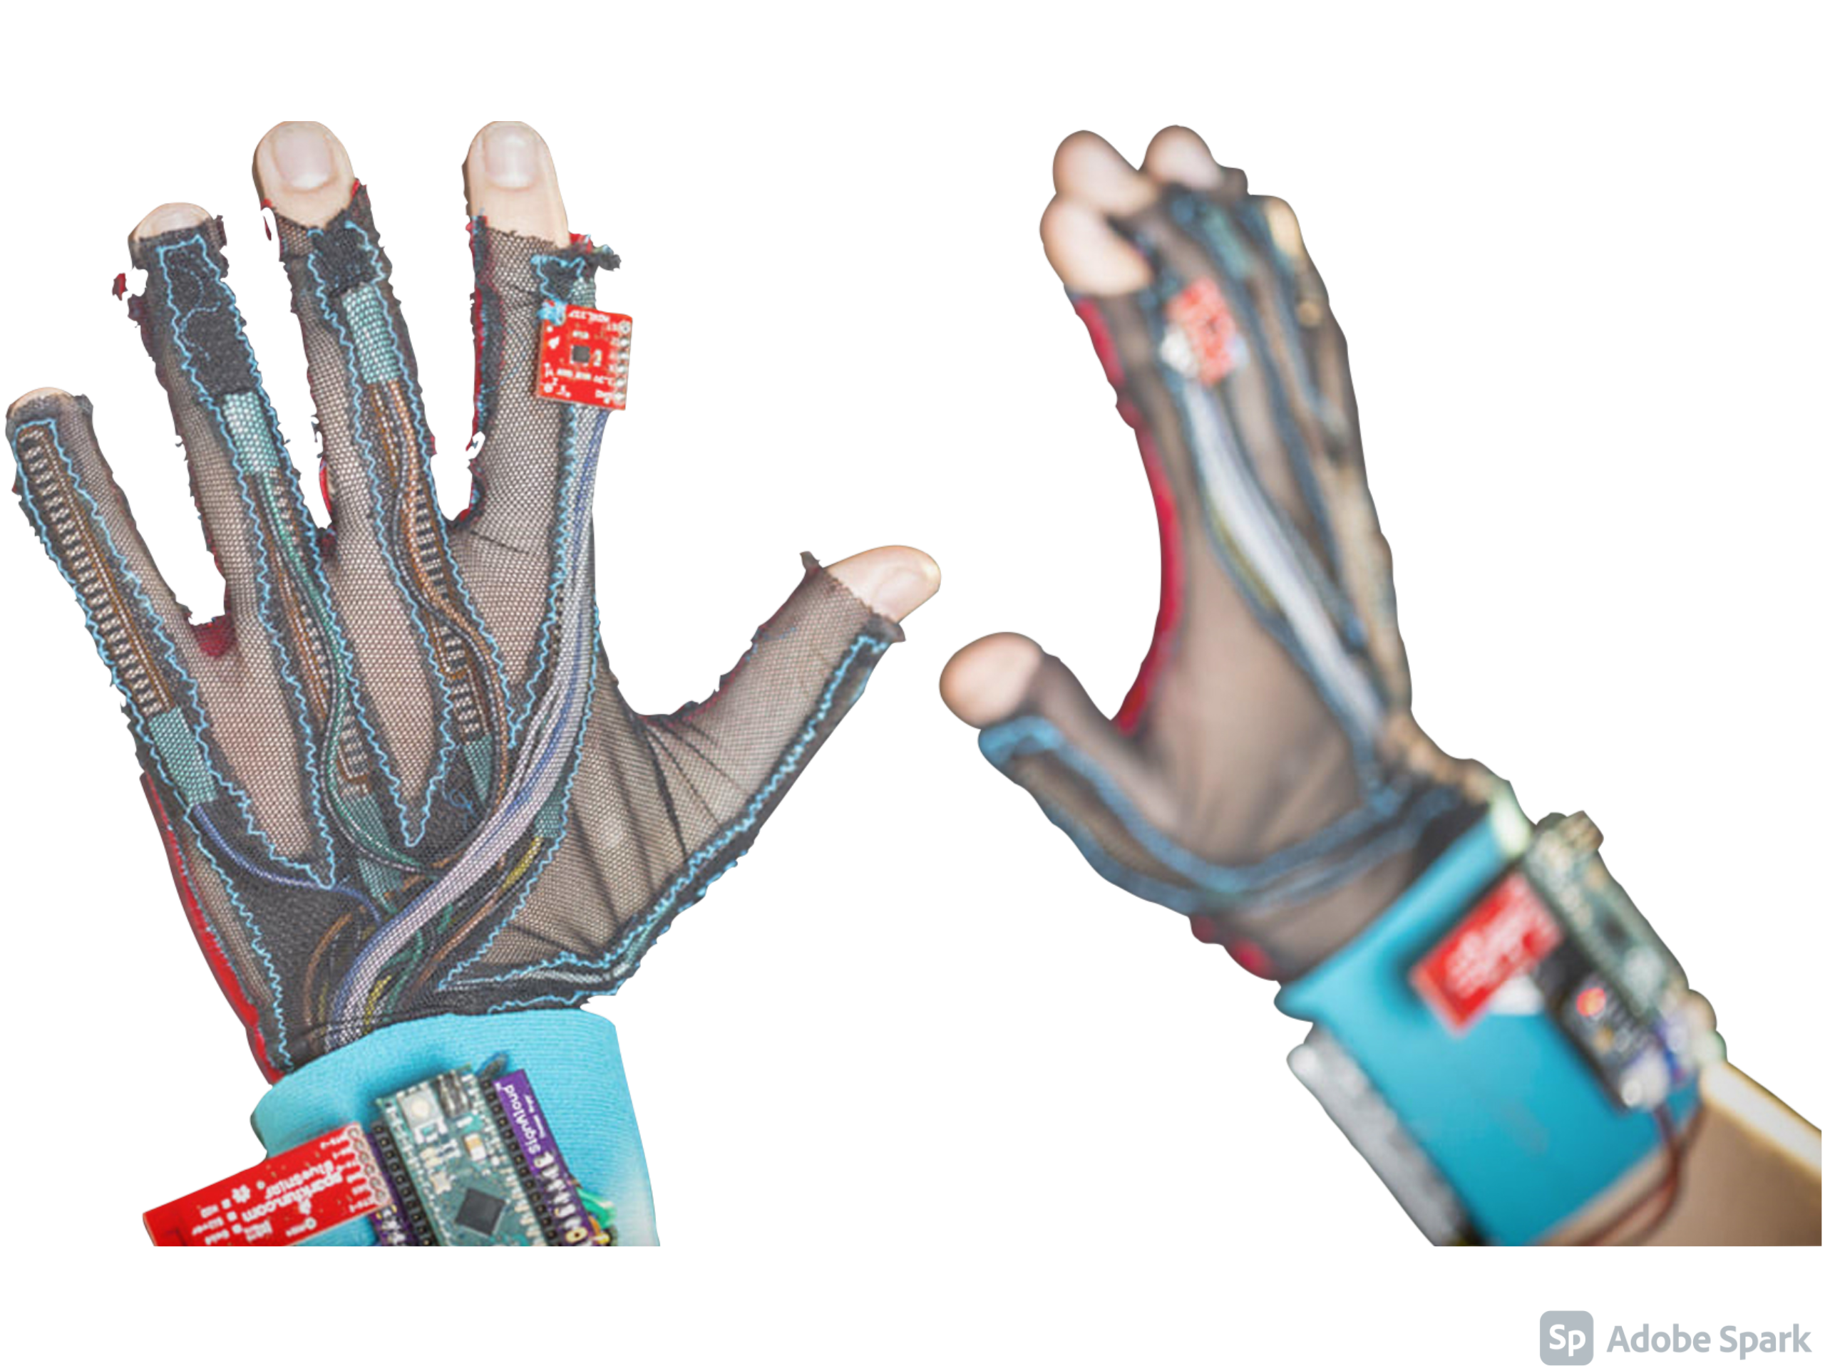
Sign Language Translator

Slide 2

OUR PURPOSE
METHODOLOGY
01
03
OUR GOALS
OUR PROGRESS
02
04
Why did we choose this particular project
Our operation procedure (Software and Hardware)
What are we aiming for
What have we achieved

Slide 3
OUR PURPOSE
01

Slide 4

OUR PURPOSE
For individuals living in a world deprived of sound. Sign language can demonstrate their points of view. However, not so many people are able to learn this language which creates a barrier between deaf people and the society. Our initiative is a hand gesture translator for deaf and mute people who interact with the world through sign language.

Slide 5
WHY IT’S STATISTICALY NEEDED IN EGYPT
10%
90%
Out of all Egypt's population, there are 7.5 million who are deaf-mute.
On a wider scale, worldwide, there are 72 million of deaf-mute people.

Slide 6
WHAT DO WE DO?
It is a prototype that makes the deaf and mute group able to introduce themselves to other people
These gloves will help in translating sign language into spoken words that can be heard out loud
Translating sign language into written words on a screen
This will make the deaf and mute more effective in society

Slide 7
OUR GOALS
02

Slide 8
USABILITY
POSITIONING
EXPANSION
OUR GOALS
We want these gloves to be easily utilized by the deaf and mute people
Being the finest in the region with the lowest price
Expanding worldwide with the best quality and pricing

Slide 9
HOW DO WE DO IT?
Compare
Compare the detected signals to the data-base
Detect
Detect the hand movement and gestures
Translate
Translate the desired words to text and speech

Slide 10
METHODOLOGY
03

Slide 11
METHODOLOGY
HARDWARE
Detector
SOFTWARE
HARDWARE
COMBINING
Translator

Slide 12
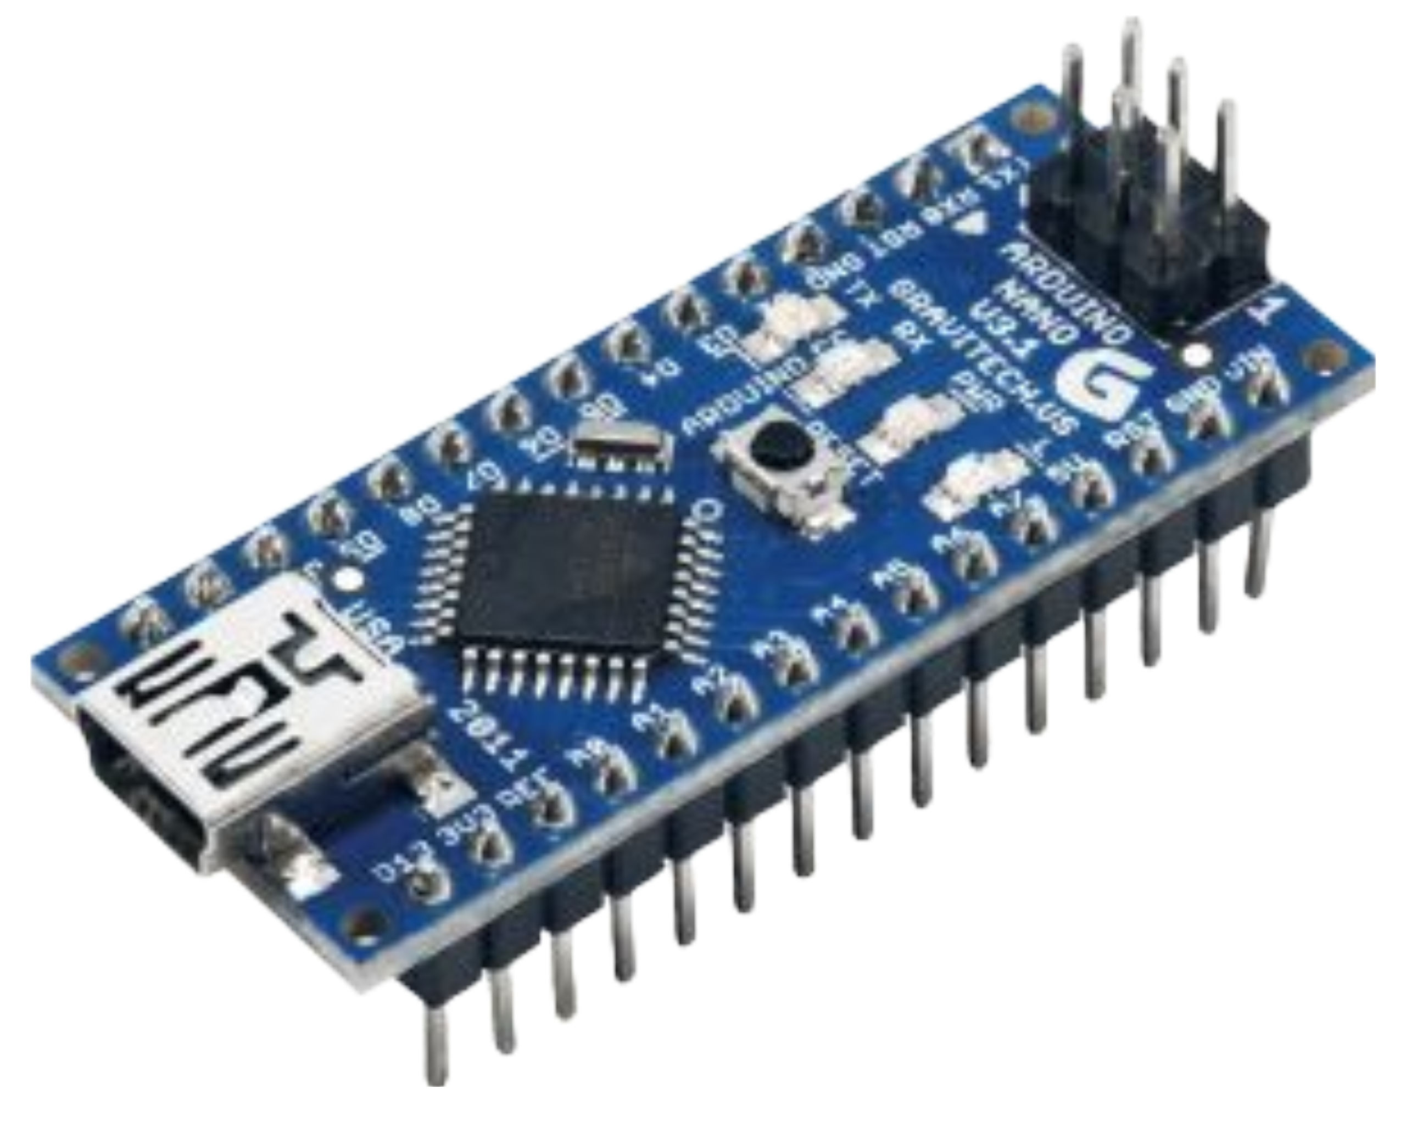
HARDWARE
Detector
Arduino Nano

Slide 13
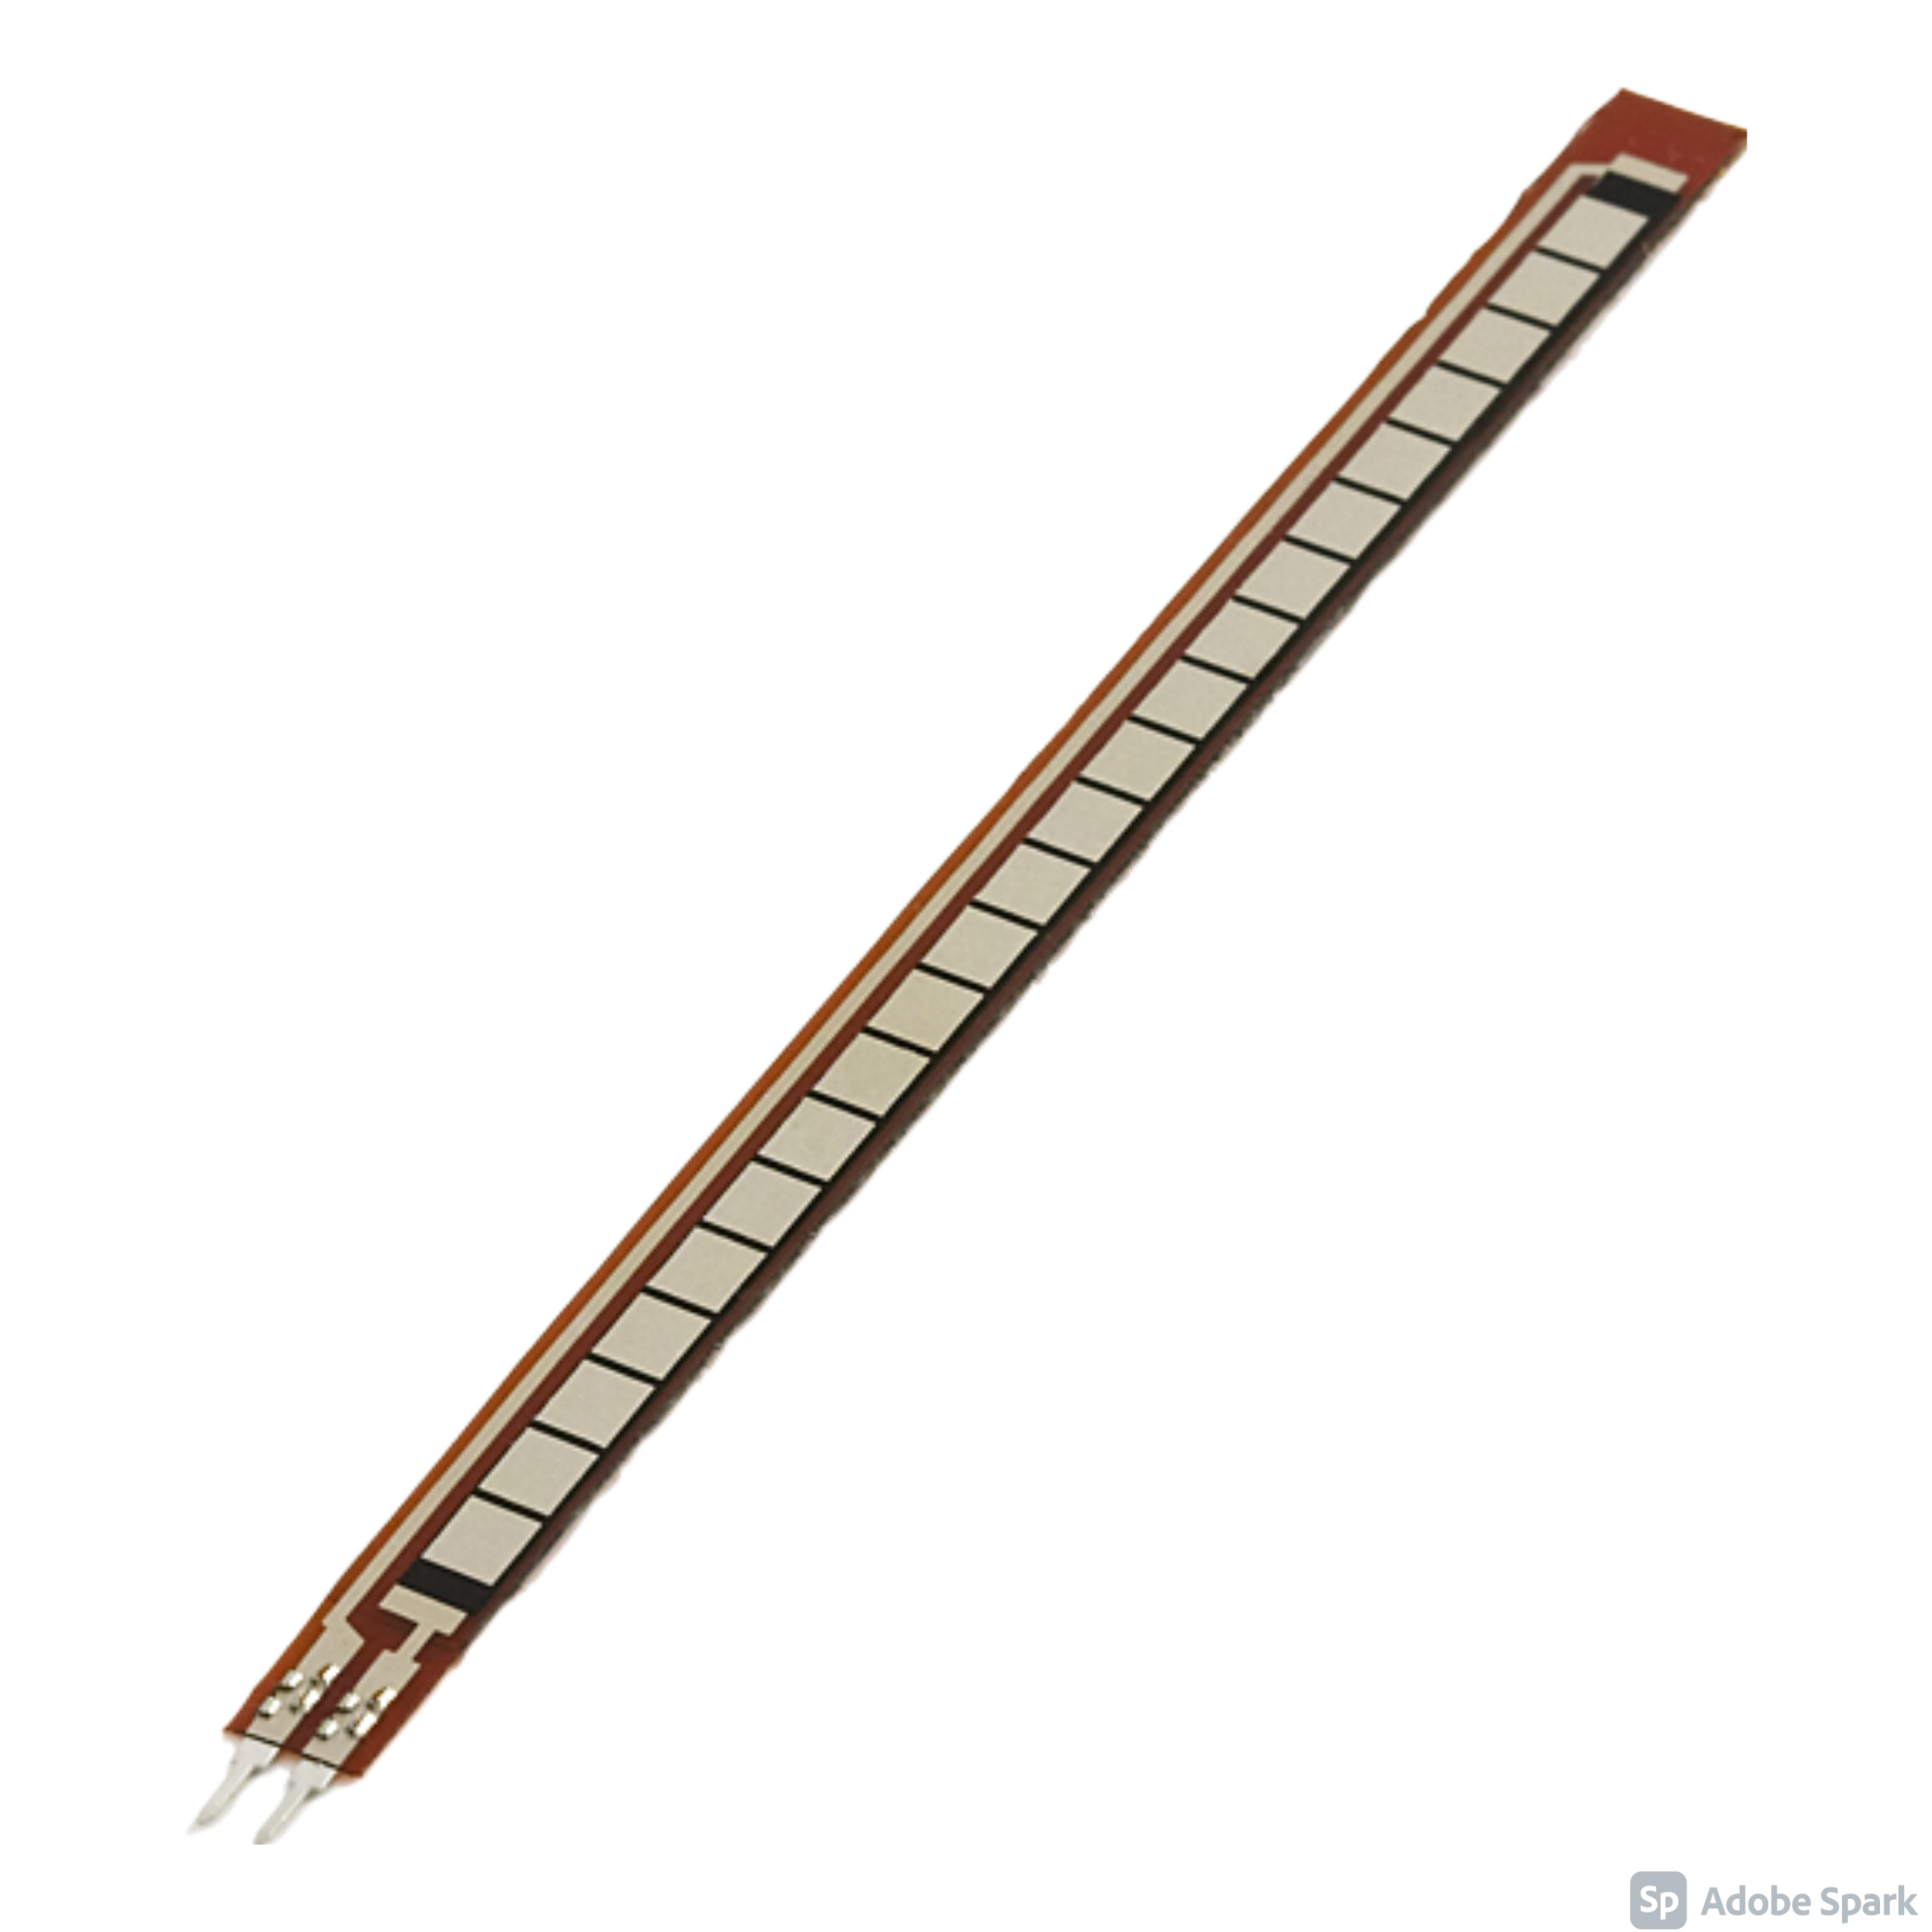
HARDWARE
Detector
Flex Sensors

Slide 14
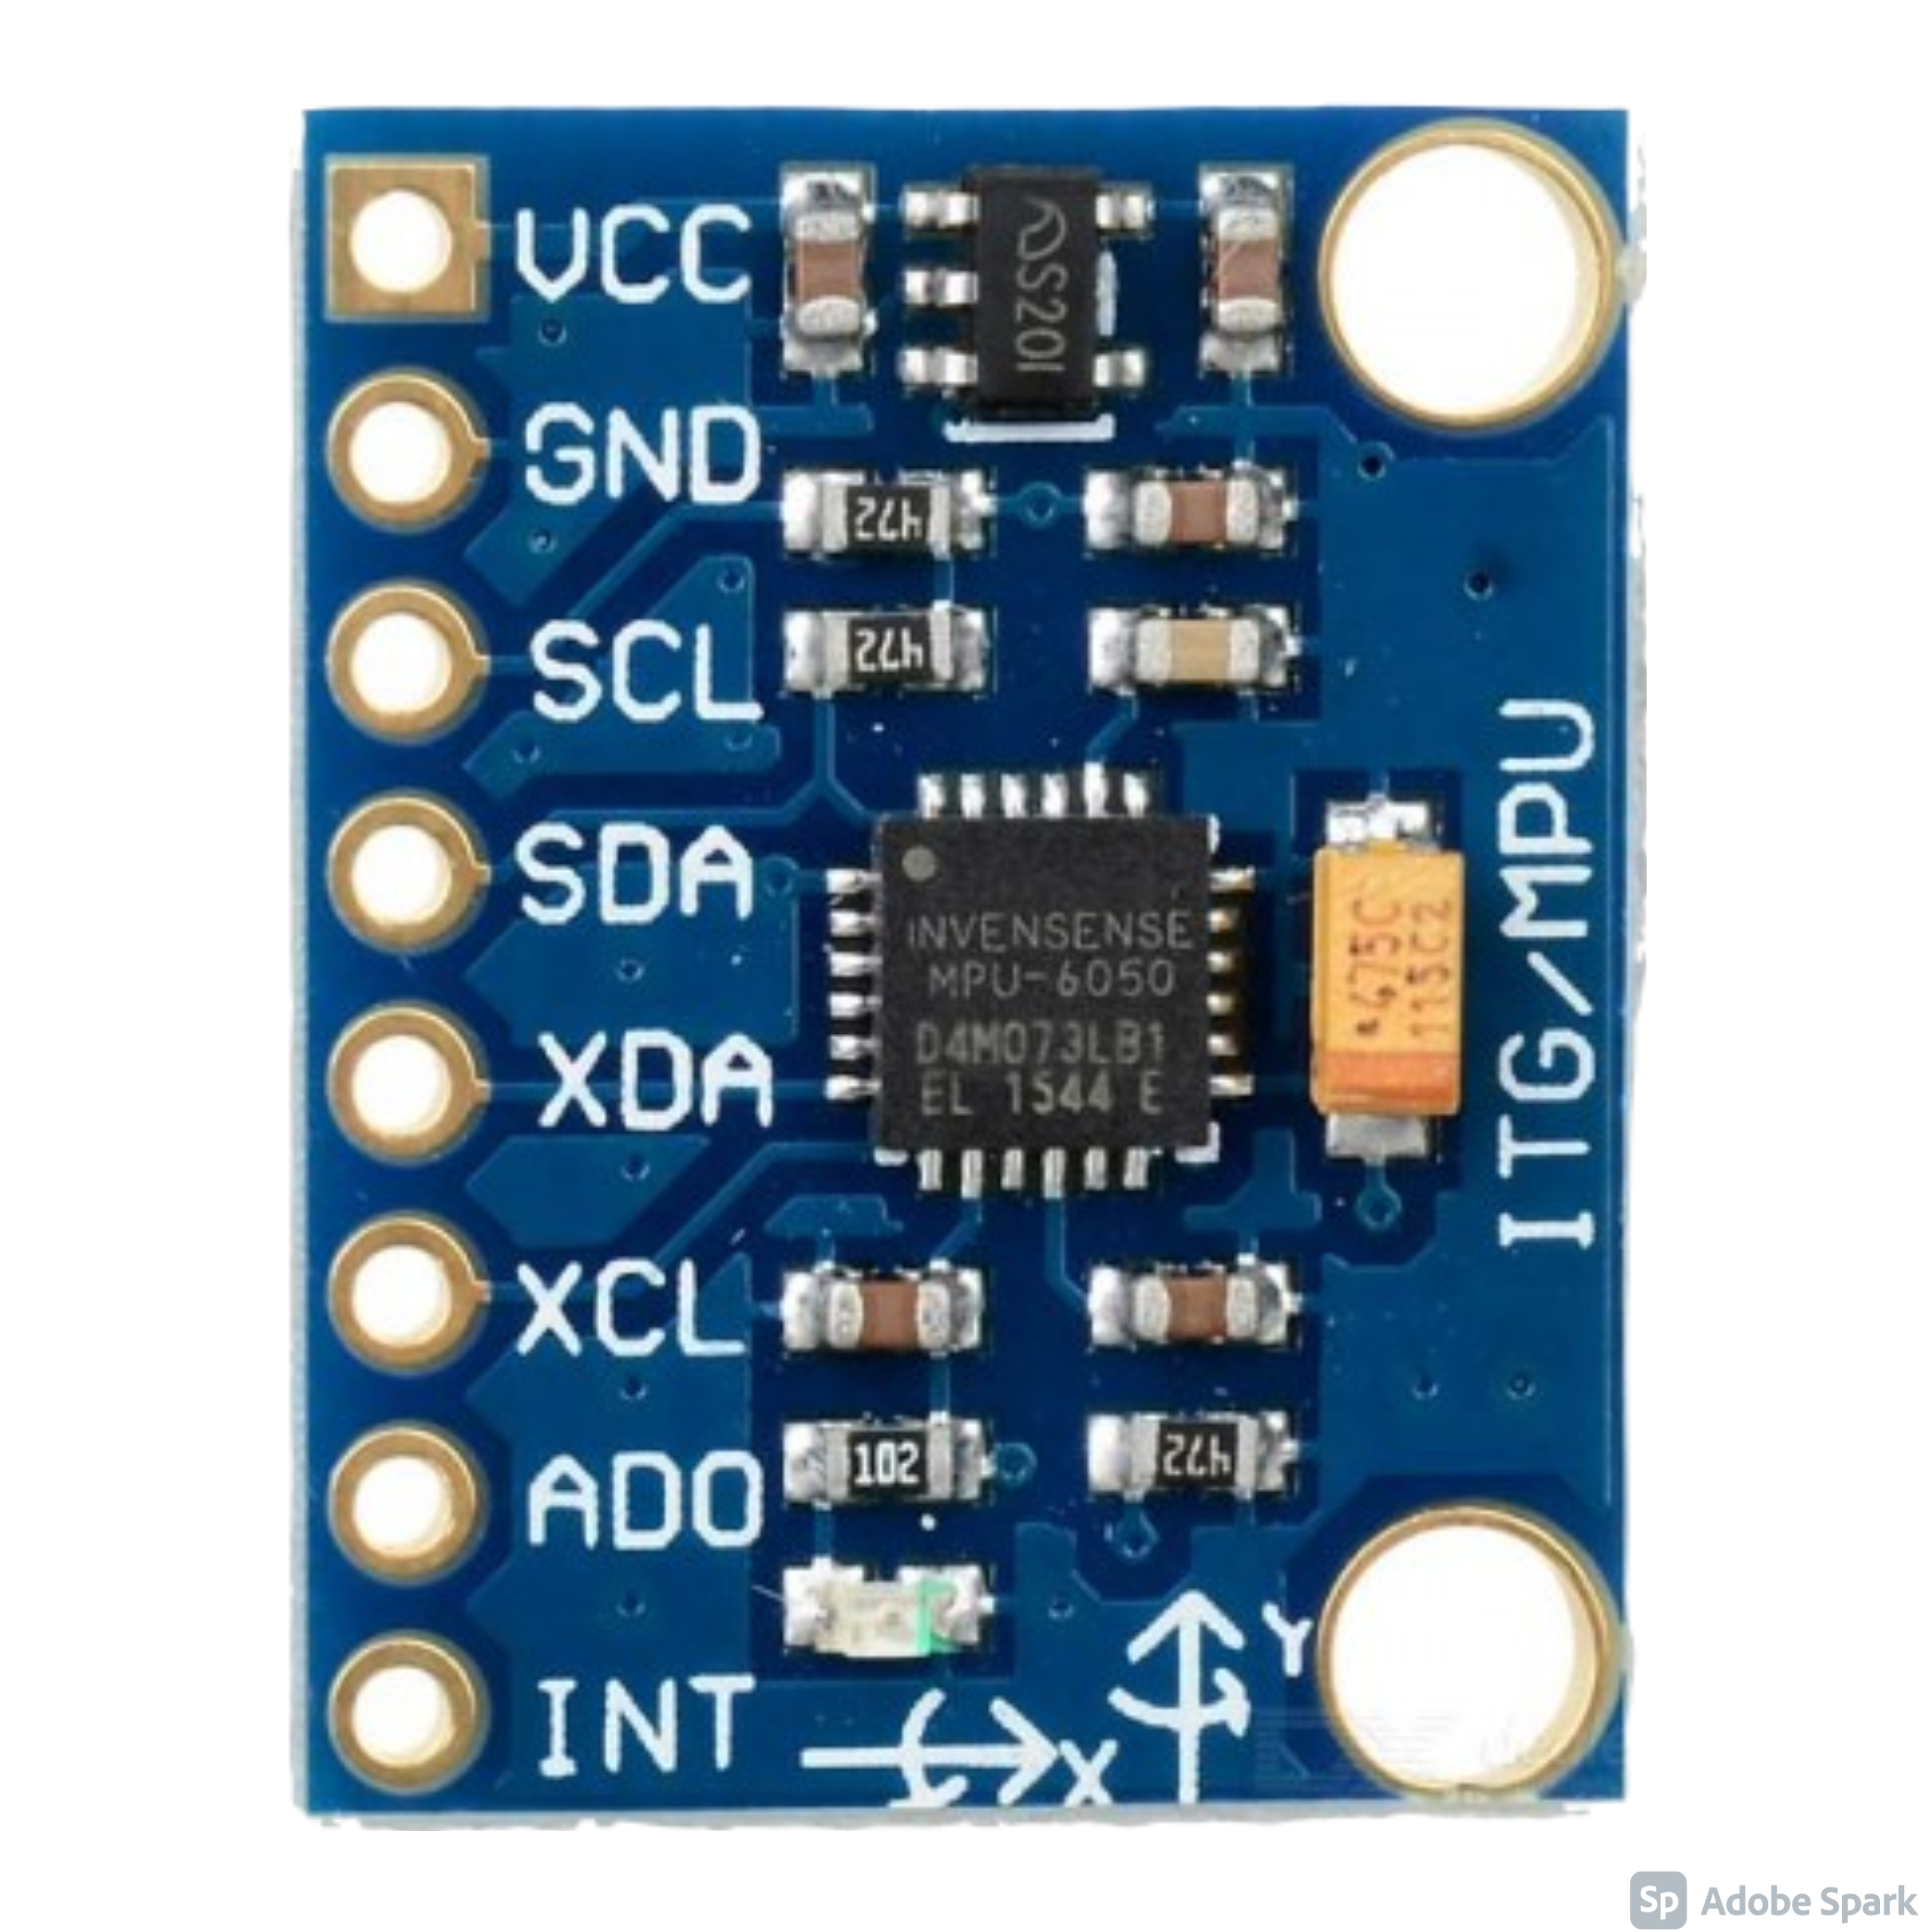
HARDWARE
Detector
MPU6050 3-axis accelerometer module

Slide 15
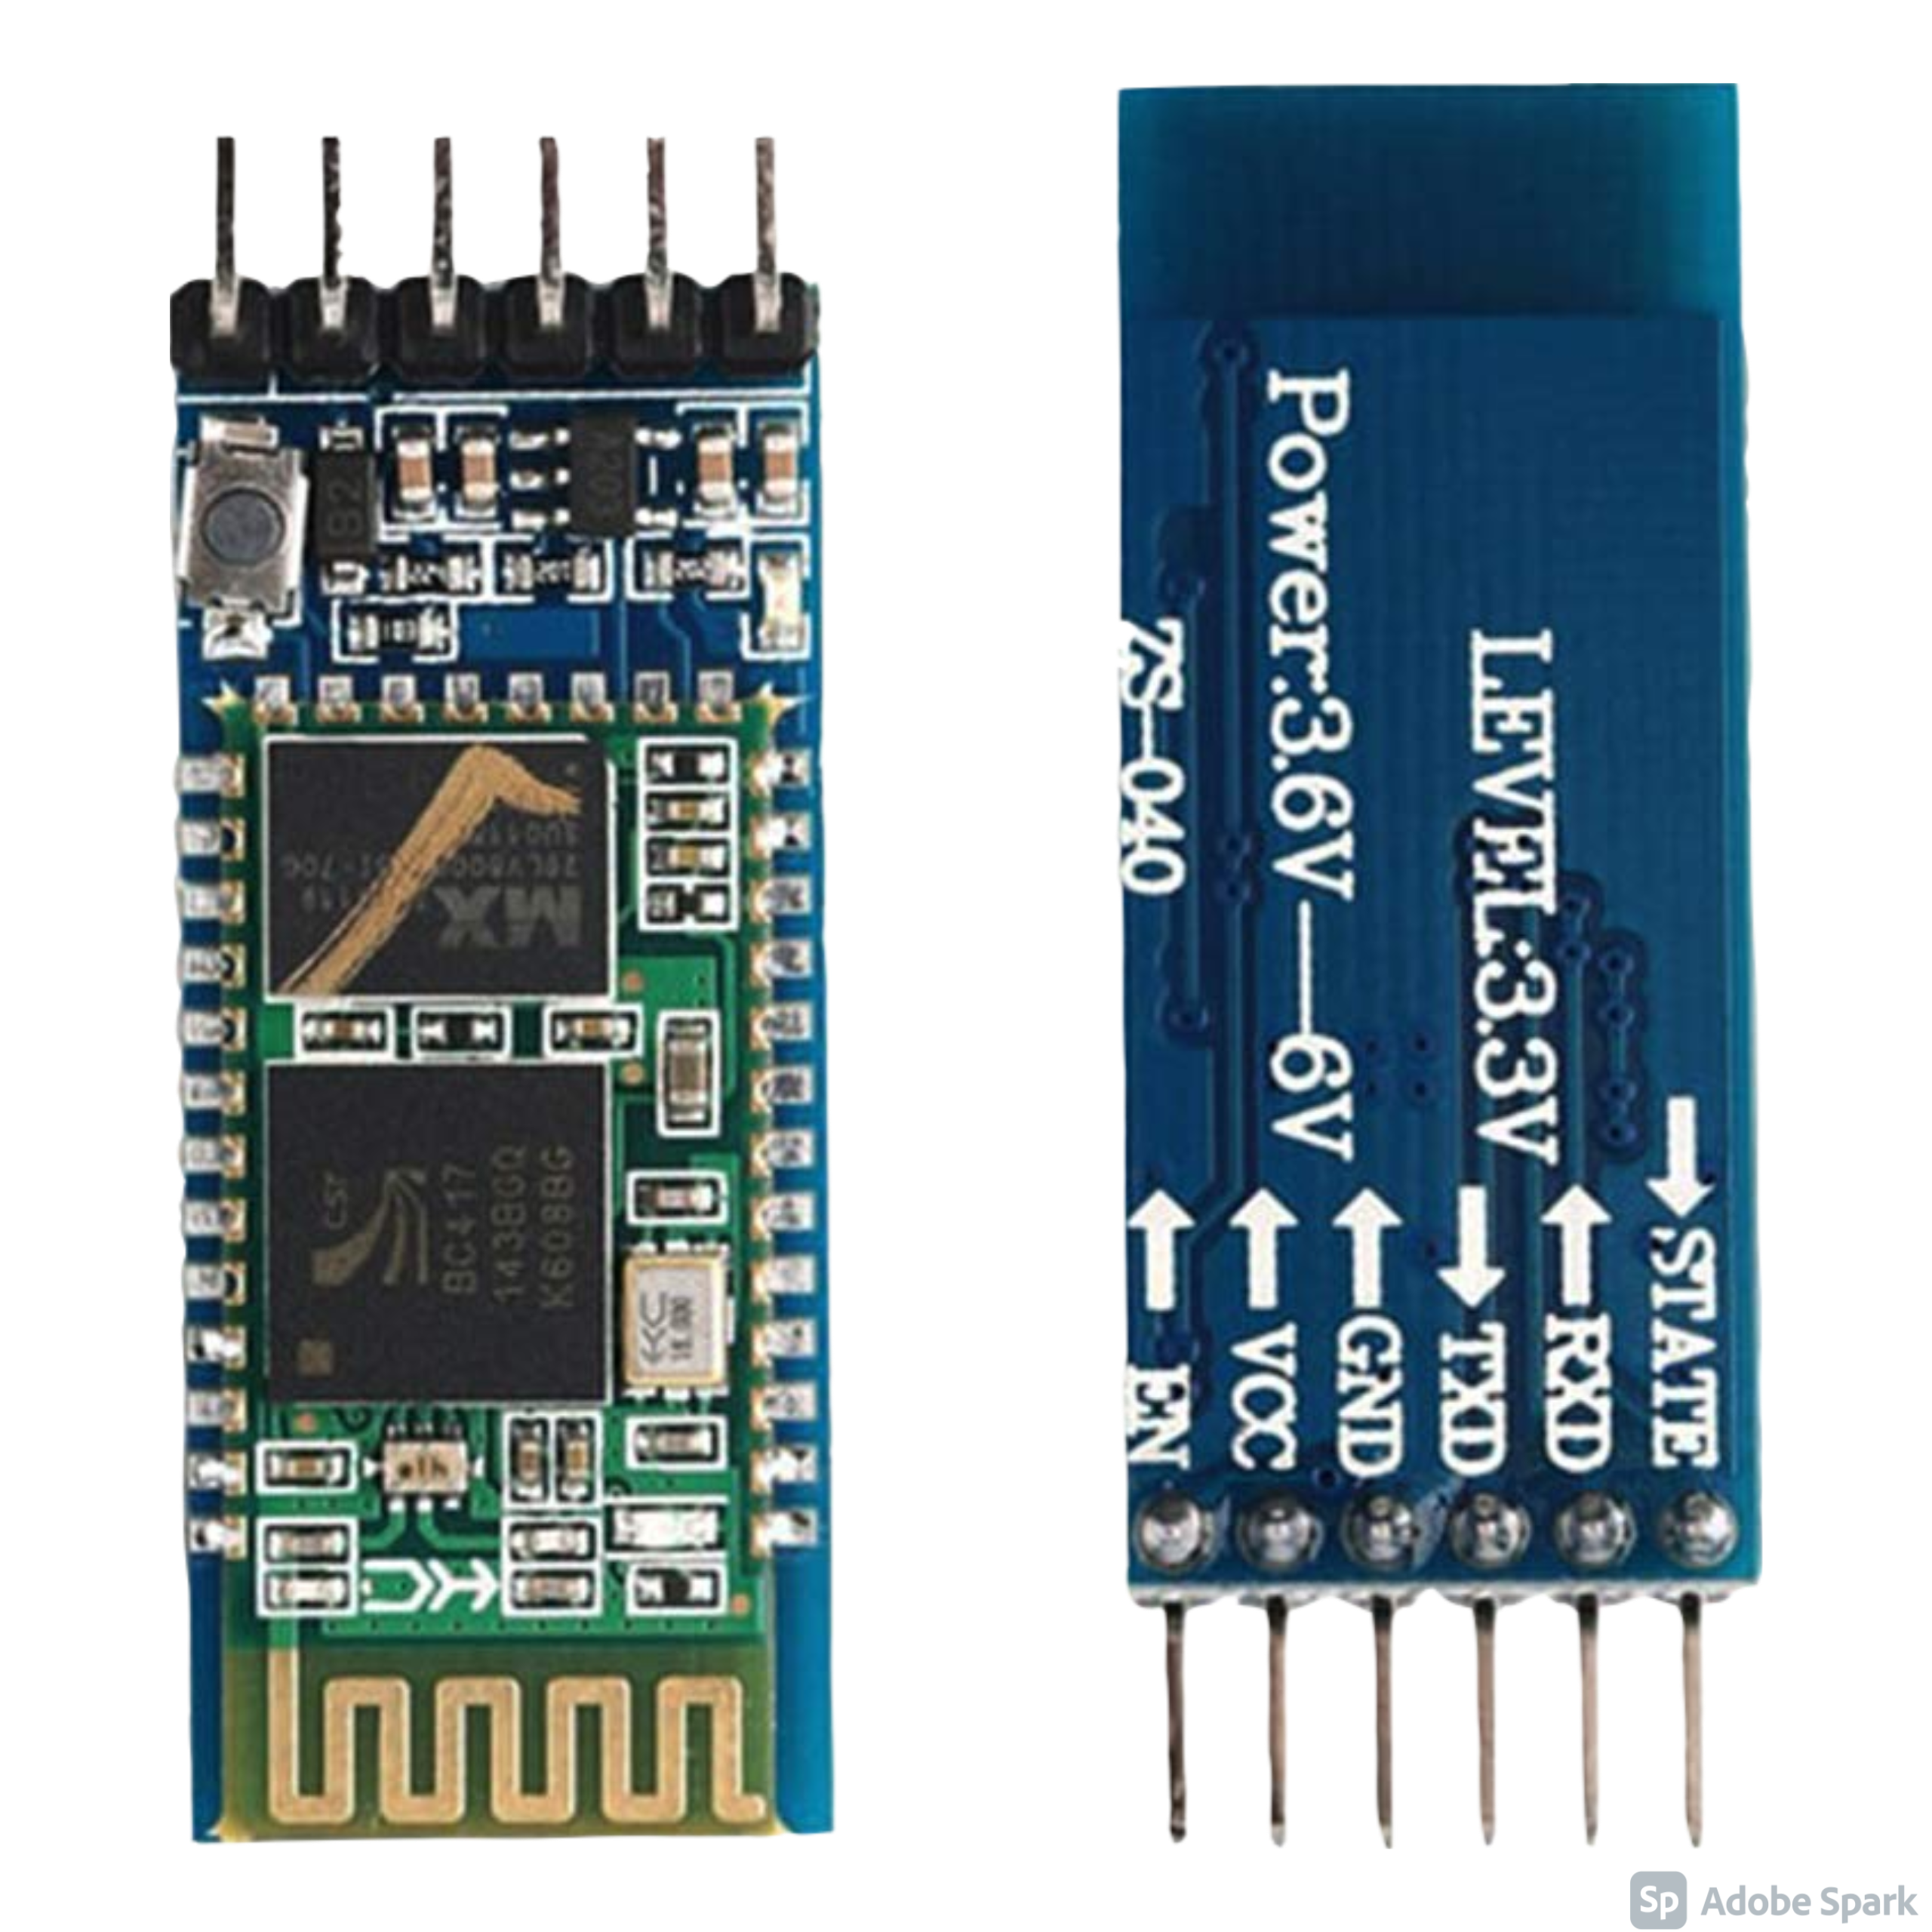
HARDWARE
Detector
Bluetooth Module

Slide 16
HARDWARE
Translator
Bluetooth Module

Slide 17
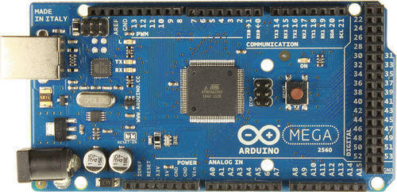
HARDWARE
Translator
Arduino Mega

Slide 18
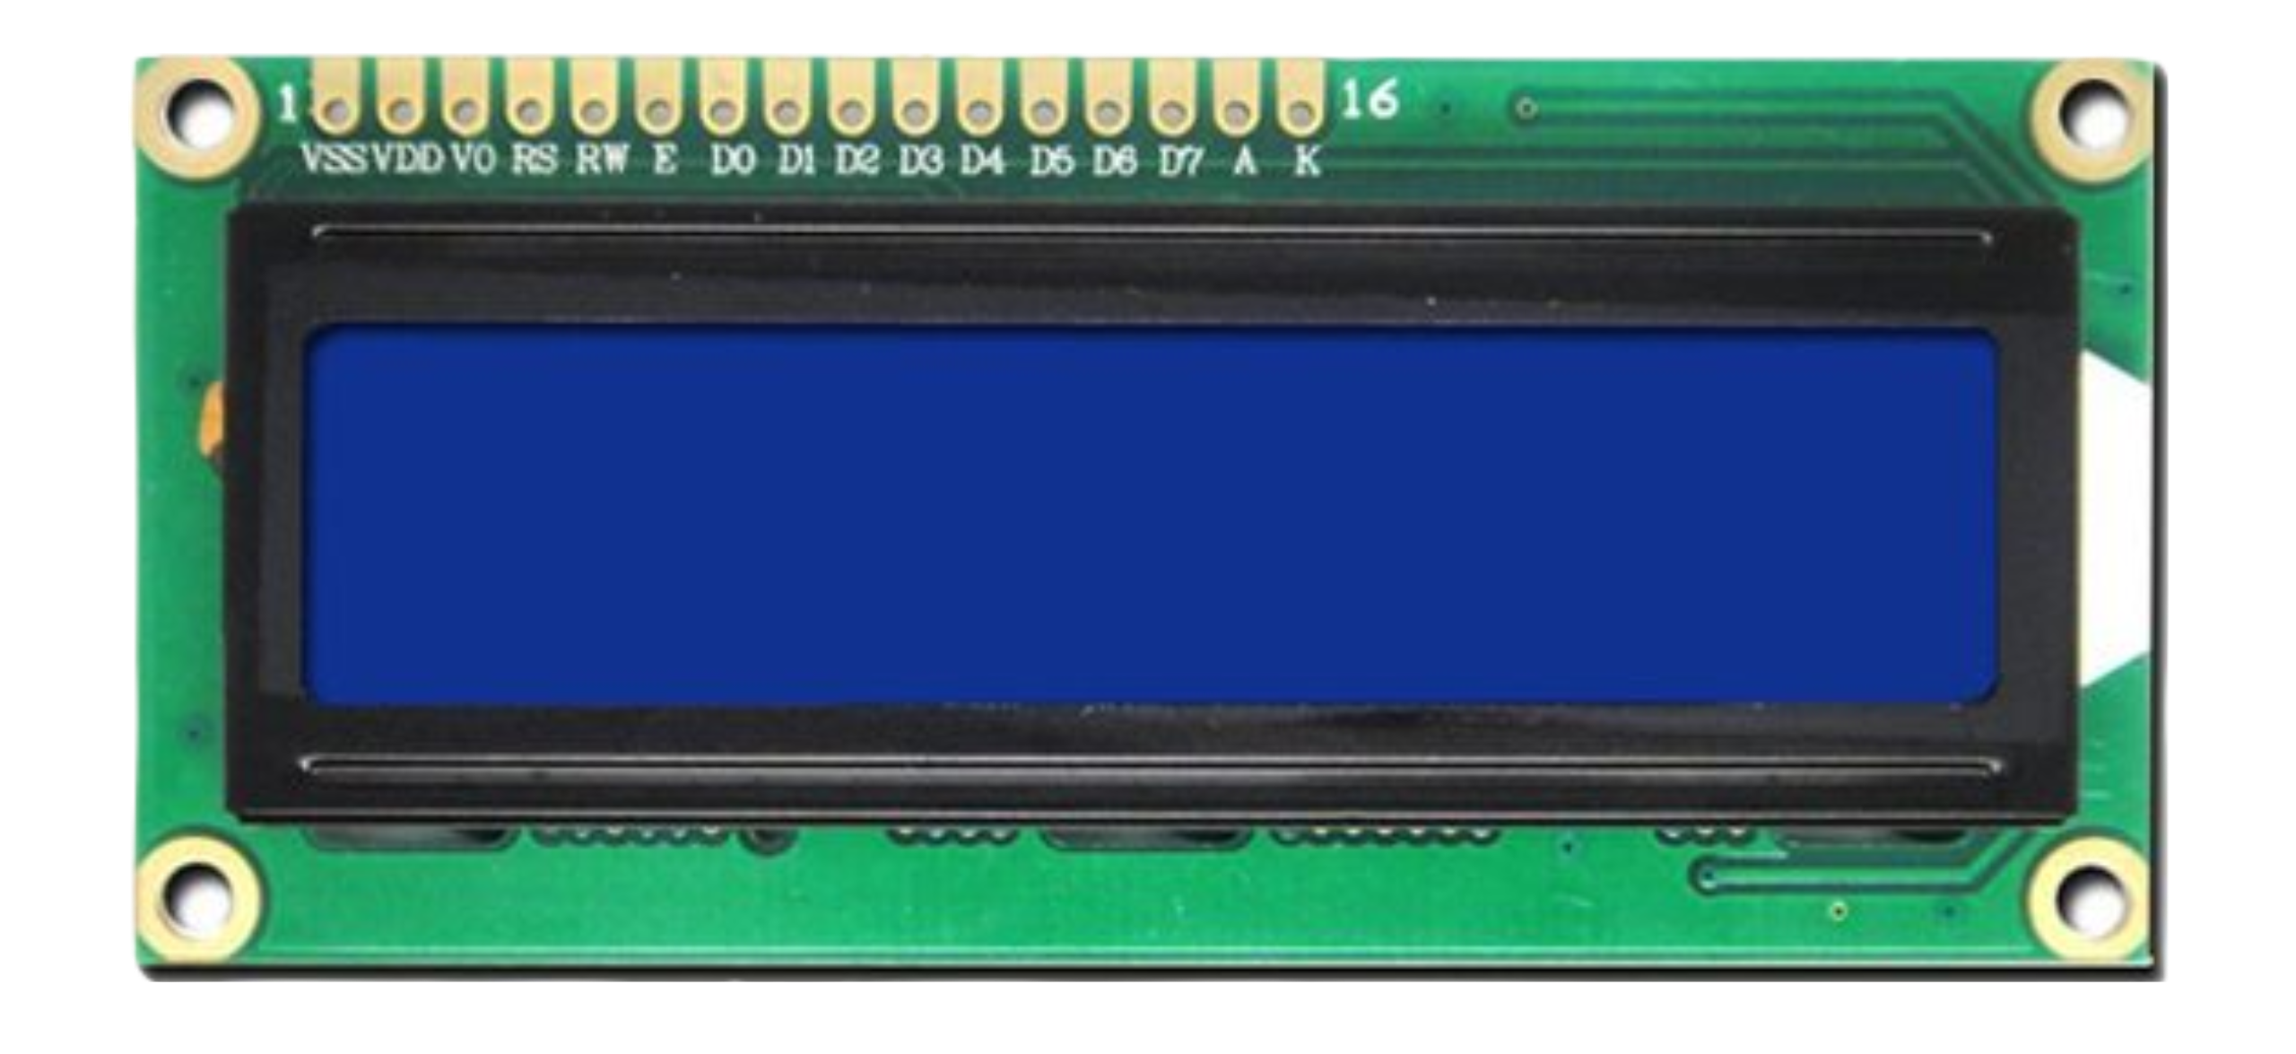
HARDWARE
Translator
LCD

Slide 19
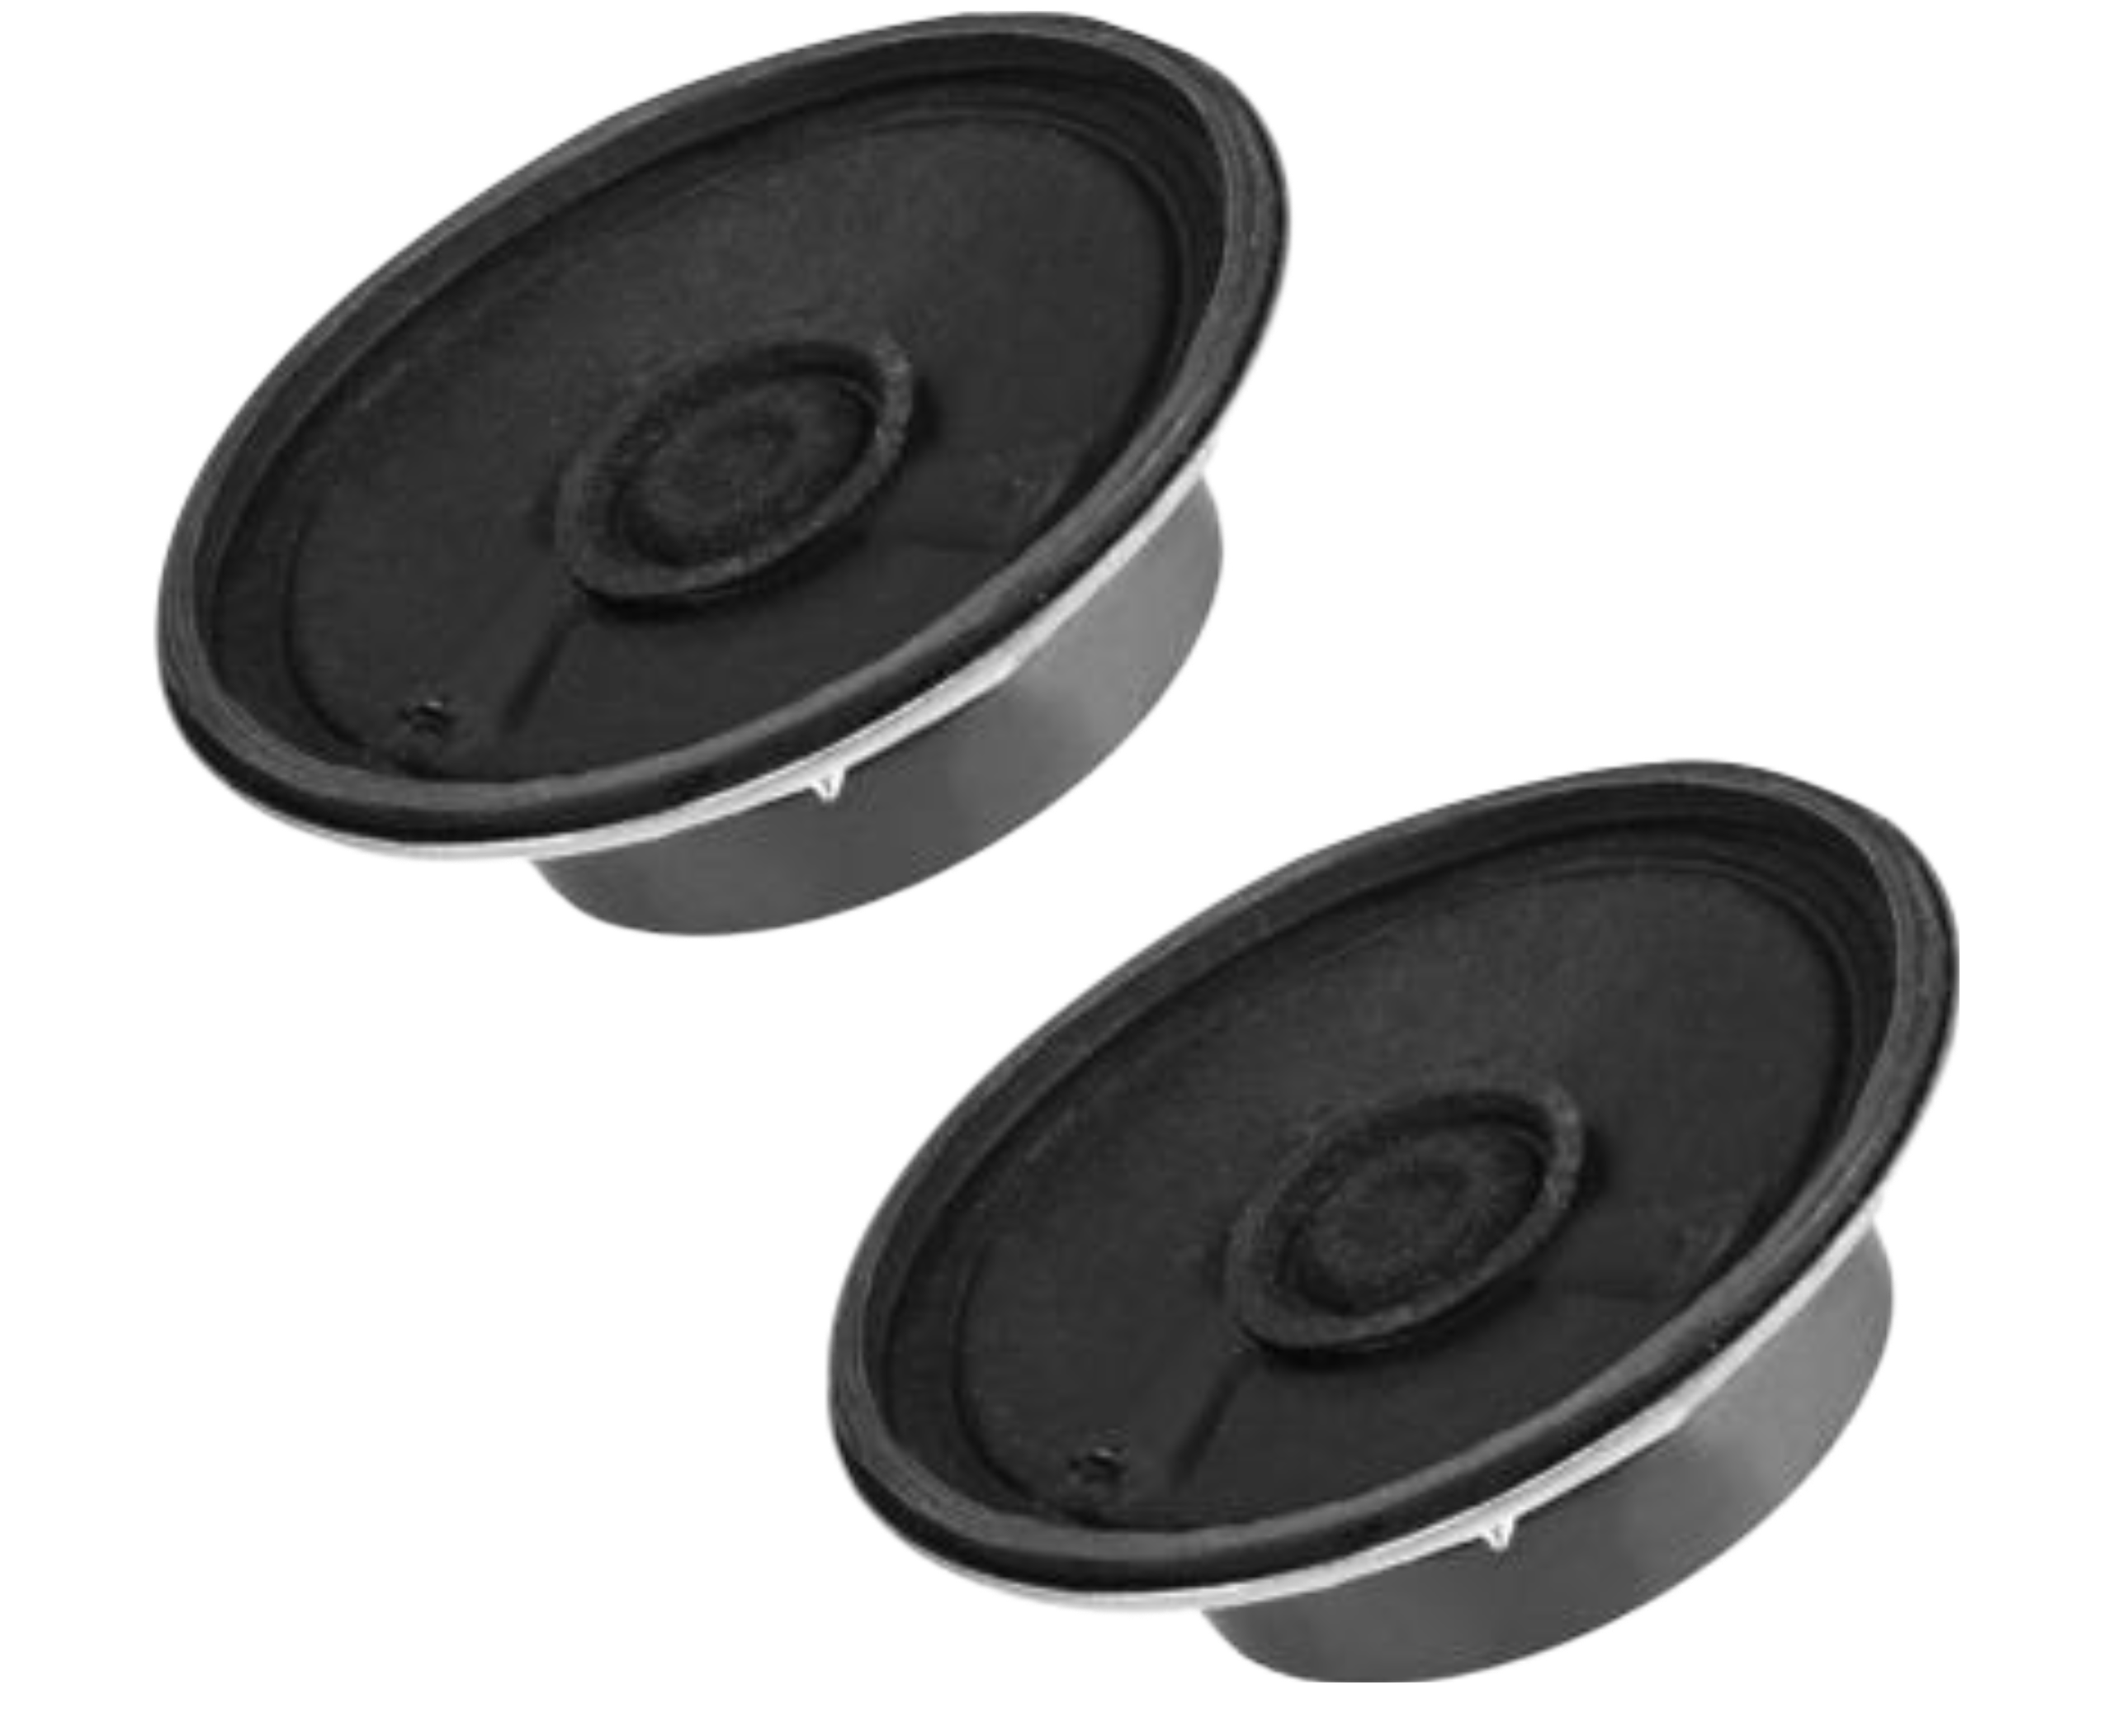
HARDWARE
Translator
Speakers

Slide 20
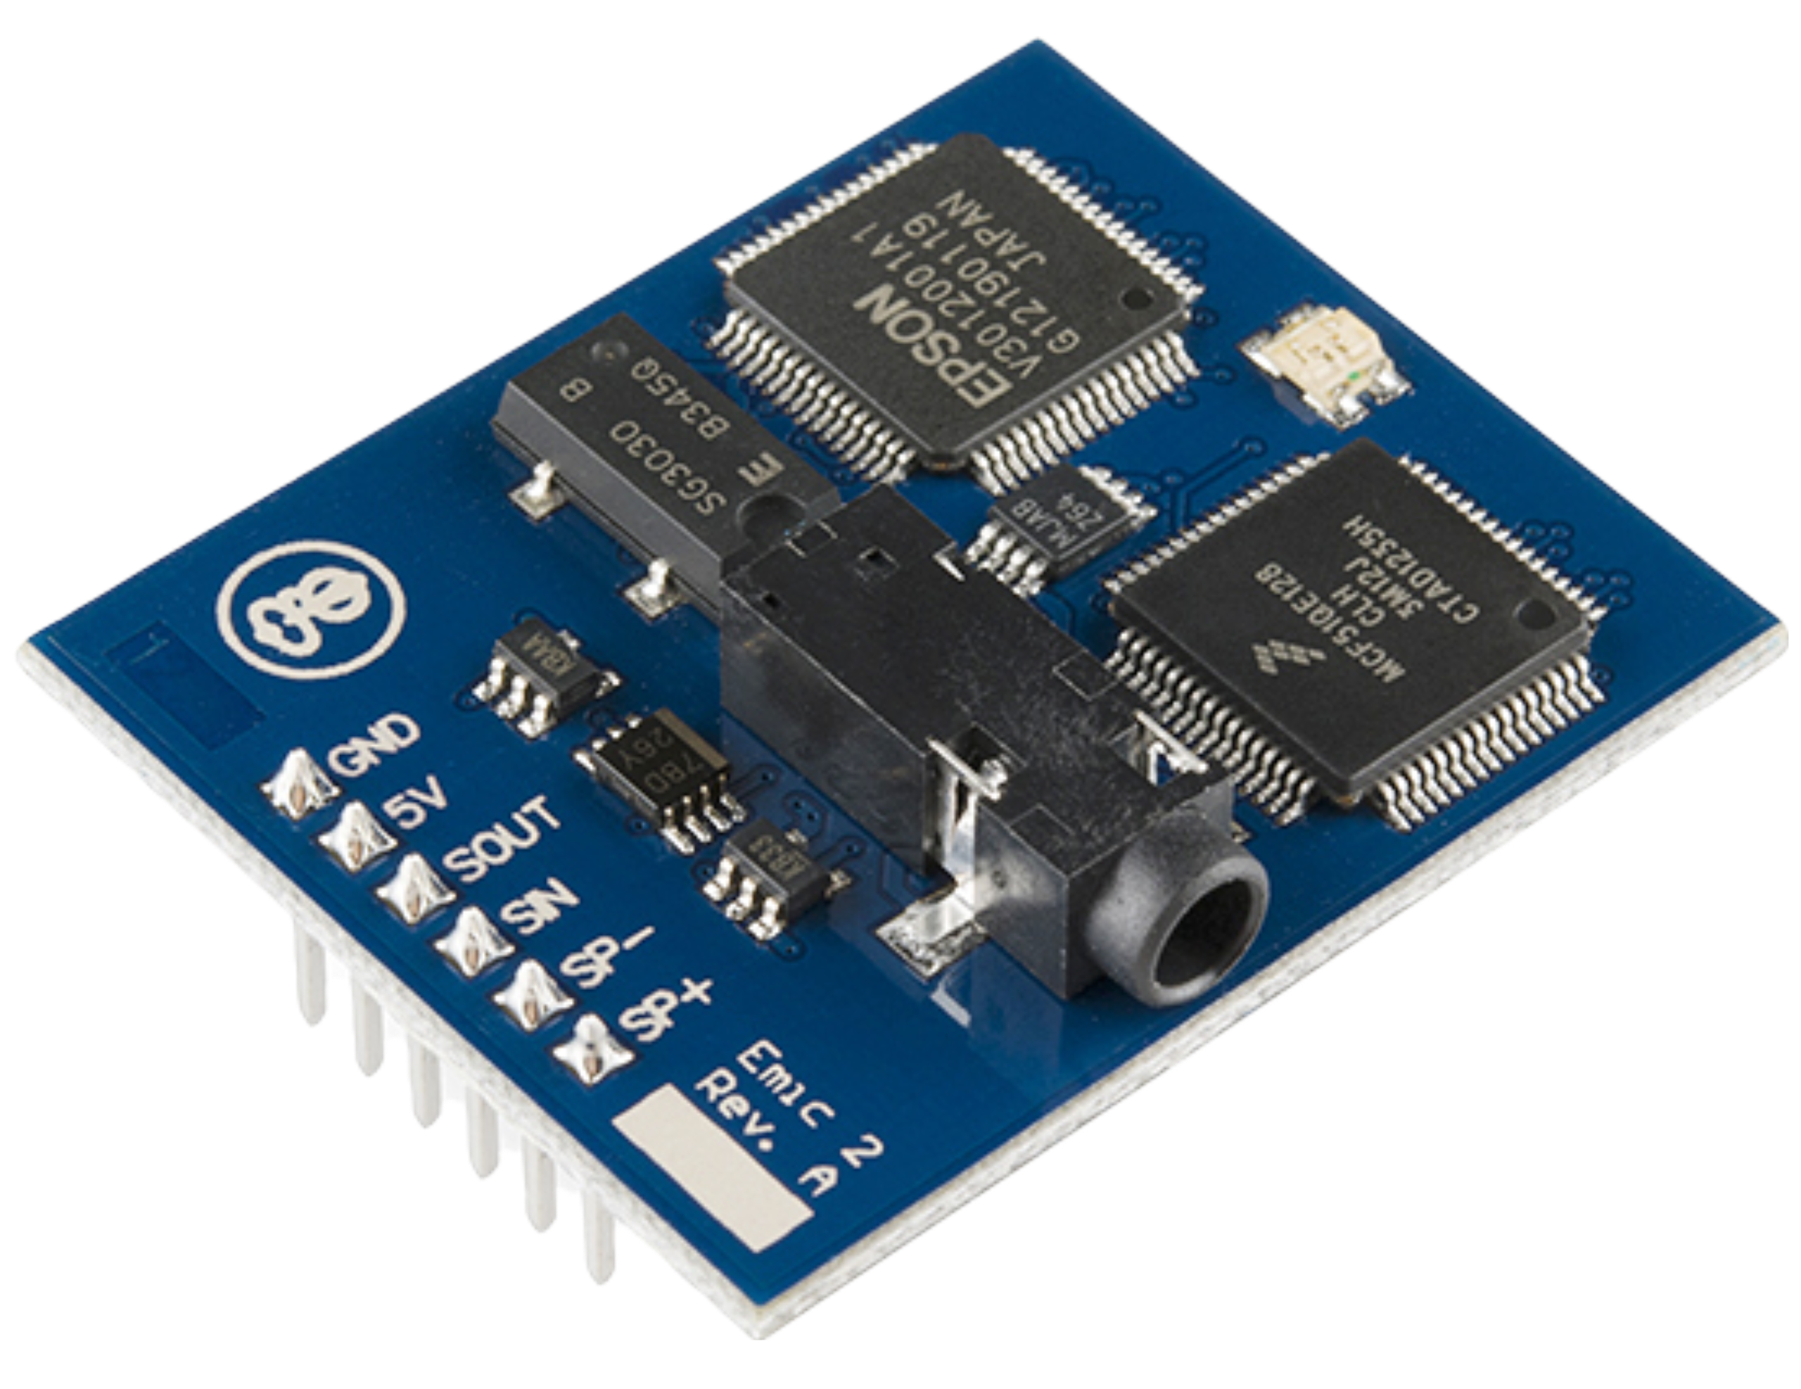
HARDWARE
Translator
Text-to-Speech Module

Slide 21
METHODOLOGY
HARDWARE
Detector
SOFTWARE
HARDWARE
COMBINING
Translator

Slide 22
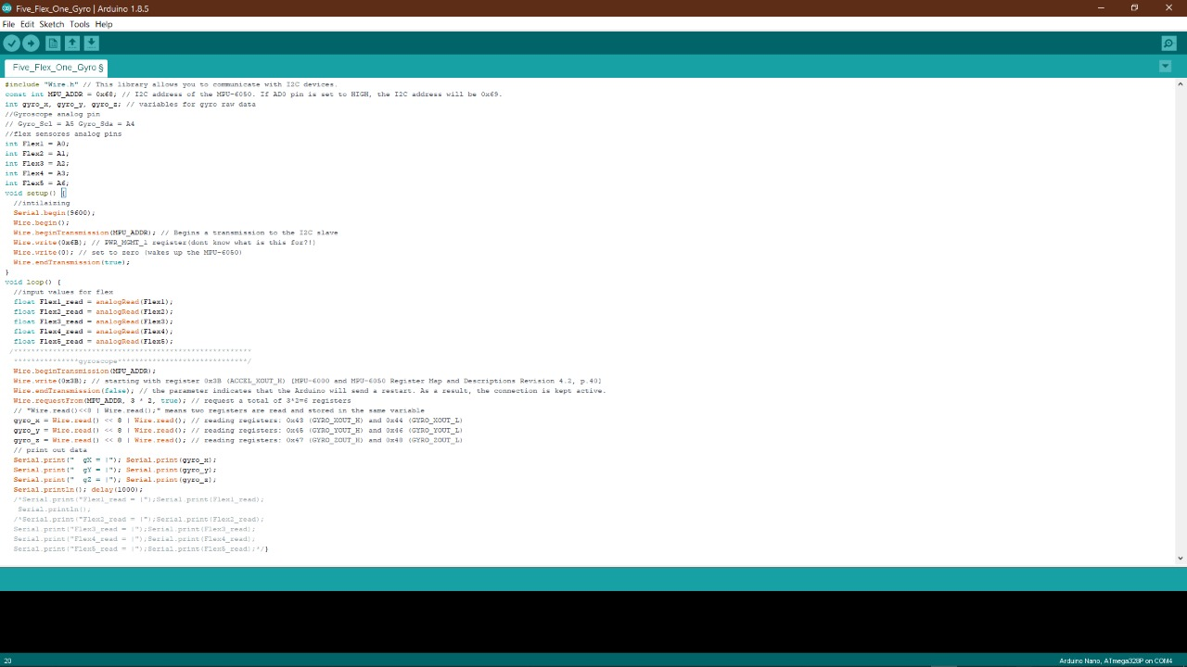
SOFTWARE
C programming language will be used to program the Arduino and we will use these software for programming and simulation:
• Arduino IDE.
• Protues for simulation and PCB design.

Slide 23
OUR PROGRESS
04

Slide 24
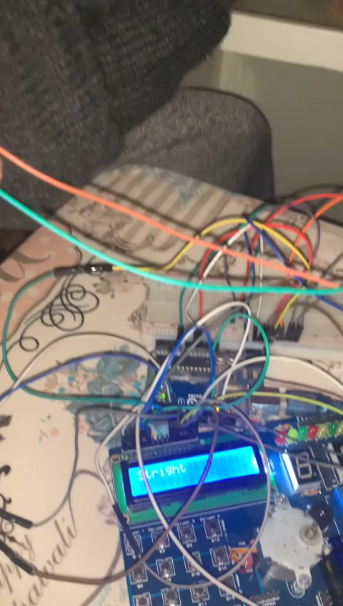
OUR PROGRESS

Slide 25
OUR PROGRESS
NUMBERS
LETTERS
Successfully translated the numbers in one hand
Successfully translated most of the letters
WORDS
ARABIC
Still in process
Phase 2 of the gloves after finishing the English part

Slide 26
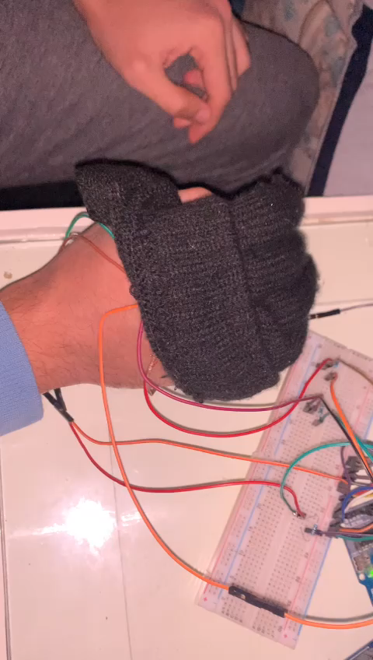
NUMBERS

Slide 27
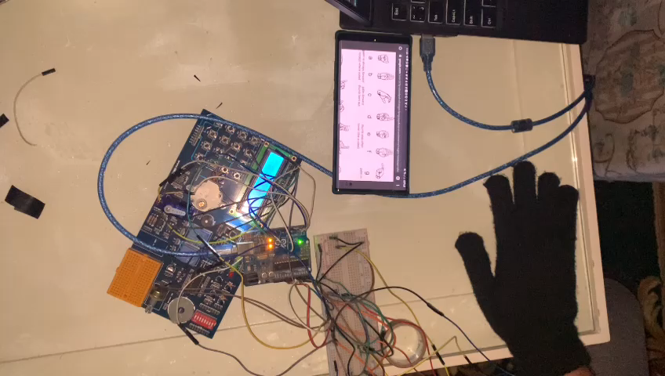
LETTERS

Slide 28
MEET THE TEAM
Mahmoud Nageh
Ahmed Emad
Hussien Hamdy
Mira Sameh
Hazem Mohammed
Mennatullah Youssef
Mohammed Ashraf
Fatma Nasser

